Slide 1
GameGraph Nano
technical implementation

Slide 2
Project Summary
The project demonstrates the principles of GameGraph
It consists of three parts:
Game Client
Proxy component to work with Hedera HashGraph
A set of smart contracts that implement the logic of the Platform

Slide 3
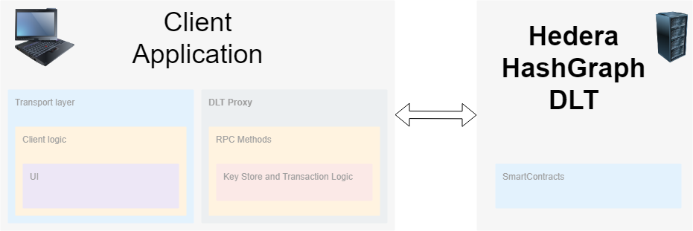
Project architecture

Slide 4
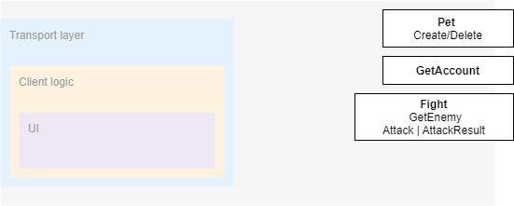
Client Realization

Slide 5
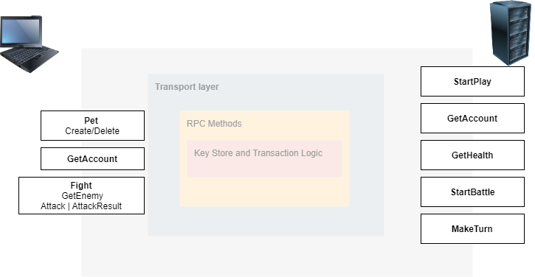
Proxy Realization

Slide 6
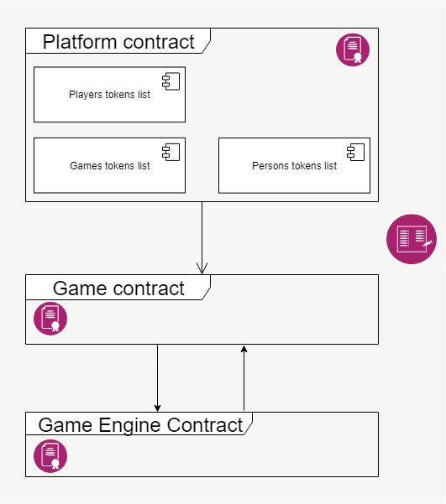
Smart Contracts Realization

